Slide 1


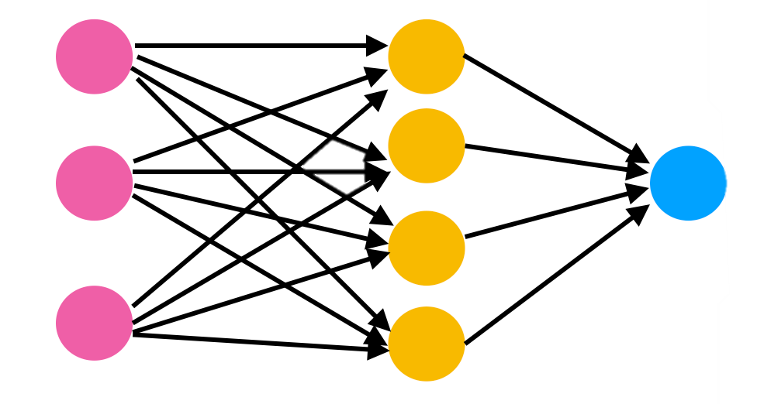
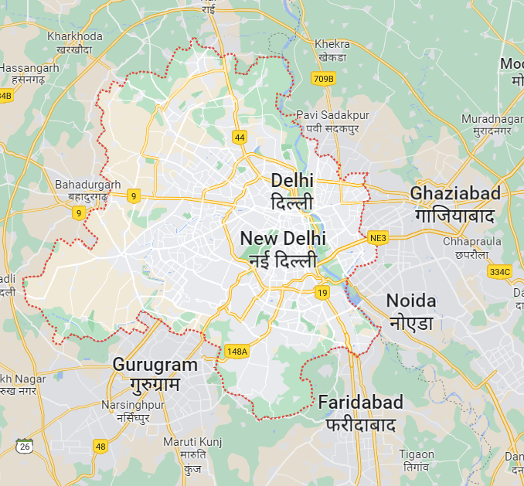

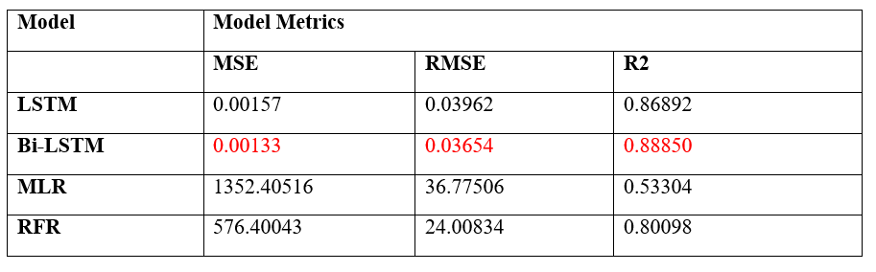
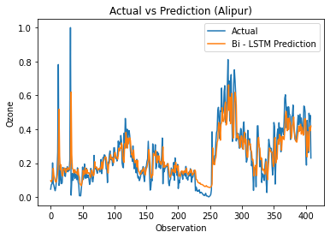
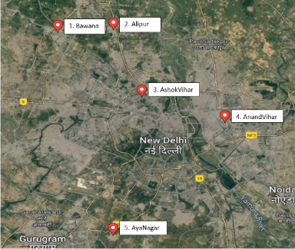
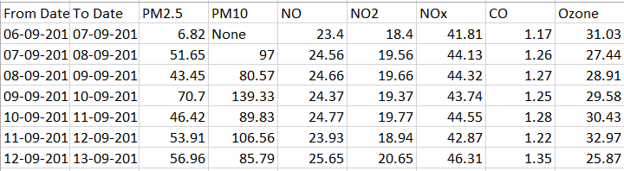

Indexing Time Series Column
Replacing Garbage values
Filling Missing Data
Splitting and transformation of data
LSTM
Bi-LSTM
MLR
RFR
O3 Data Collection
Data Preprocessing and transformation
Model Training
Ozone Forecasting and Model Evaluation

